Slide 1



“The Geography of the
Internet Infrastructure:
A simulation approach based on the Barabasi-Albert model”
Sandra Vinciguerra and Keon Frenken
URU – Utrecht University
S.Vinciguerra@geo.uu.nl
DIME workshop
Distributed Networks and the Knowledge-based Economy
10-11 May 2007

Slide 2
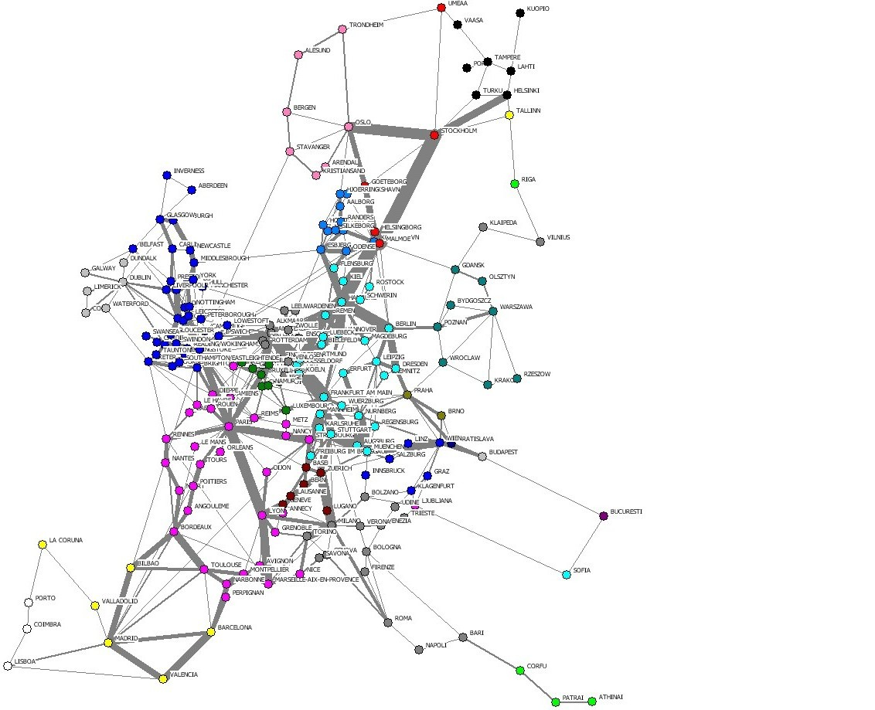
European Fiber-Optic Backbone Network - 2001

Slide 3
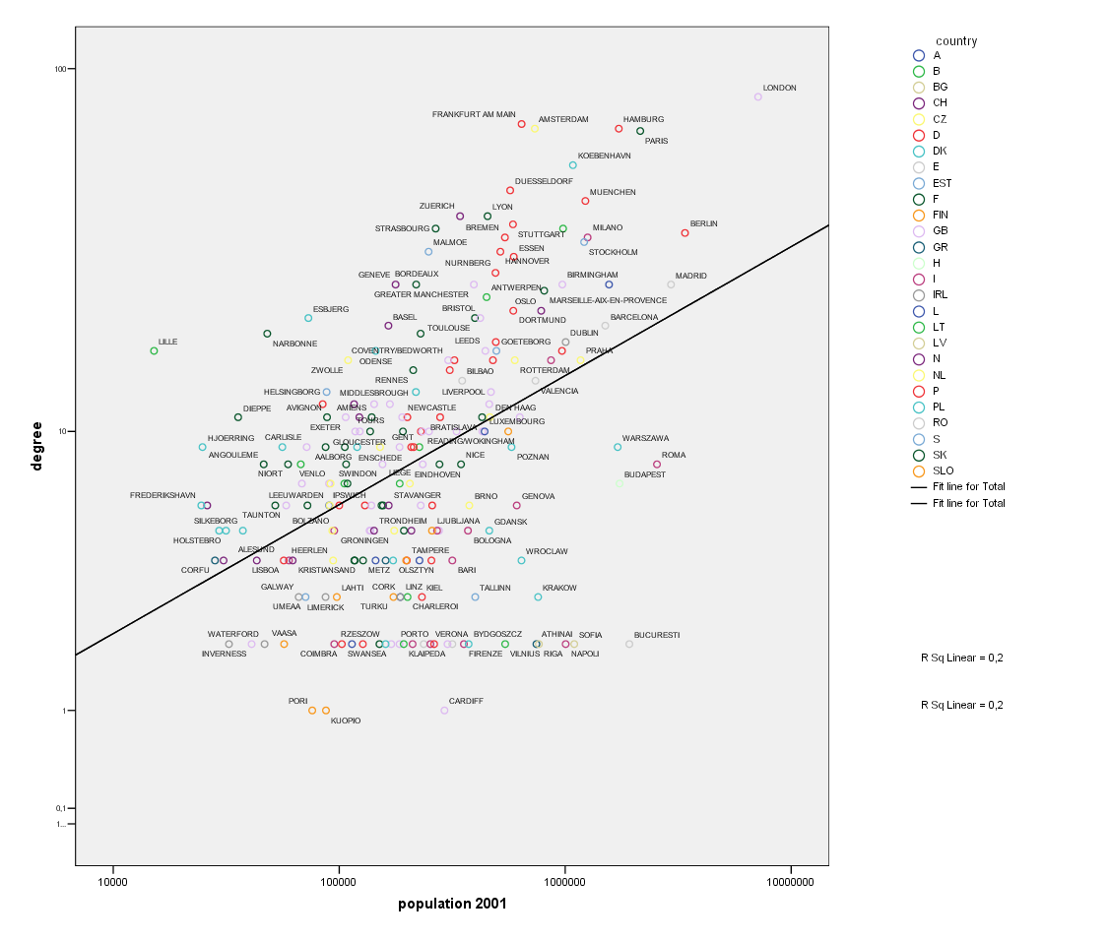
Size and providers

Slide 4
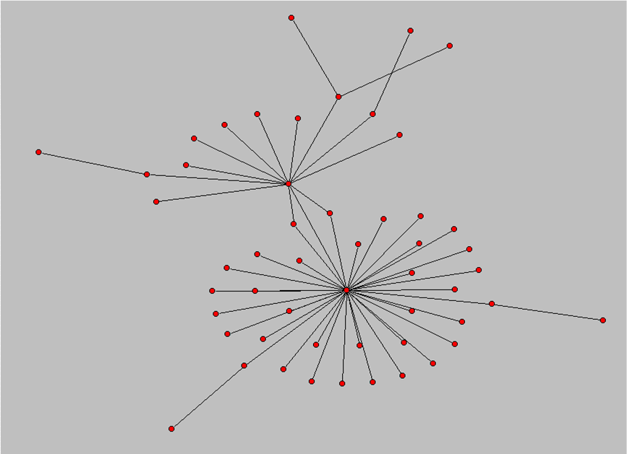
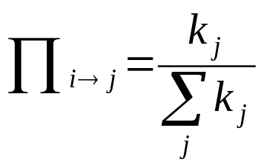
Barabàsi-Albert’s
Scale Free Network Model
The algorithm of the model is based on two mechanisms (Barabási and Albert, 1999):
Incremental Growth: networks are dynamic systems, the number of nodes grows with time;
Preferential Attachment: new nodes are not randomly connected to the existing nodes; they are linked with greater likelihood to highly connected nodes:
Scale Free networks are characterized by the presence of few nodes that are highly connected – hubs – while the majority of nodes have only a few links.
(k is the connectivity of node j)

Slide 5
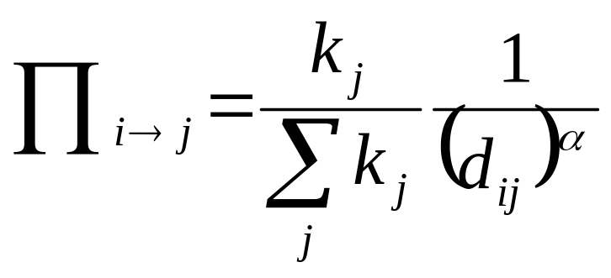
Preferential attachment in Internet infrastructure: geography matters
To reduce costs, new cities entering the network prefer:
to connect to highly connected cities
to connect to nearby cities
α ≥ 0
Pi: probability of city i to connect to city j
k_{j}: connectivity of city j
d_{ij}: geographical distance between city i and city j

Slide 6
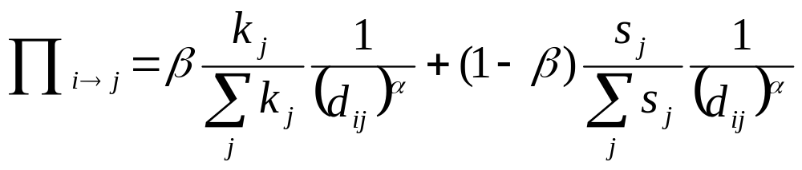
… and capacity also matters
In reality, locations already connected can increase the capacity of existing connections
A new node prefers to attach itself to nodes with high capacity (sj)
α ≥ 0, 0 ≤ β ≤ 1

Slide 7
Simulation
α=7 β=0

Slide 8
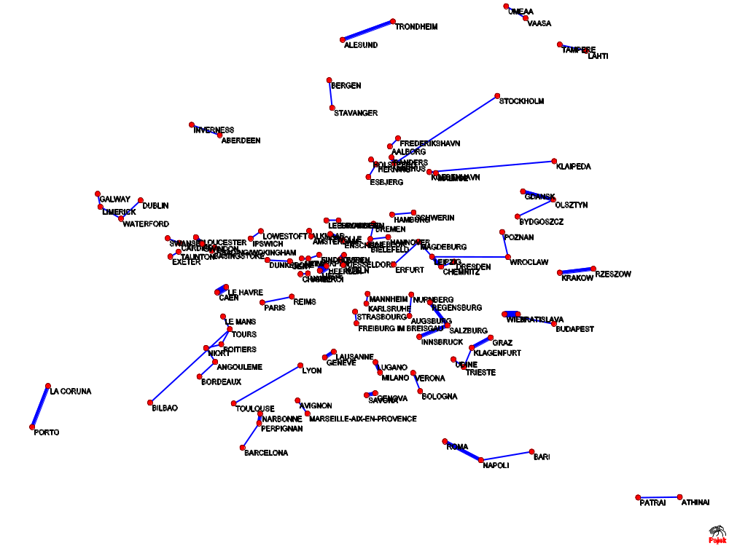
α=7 β=0

Slide 9
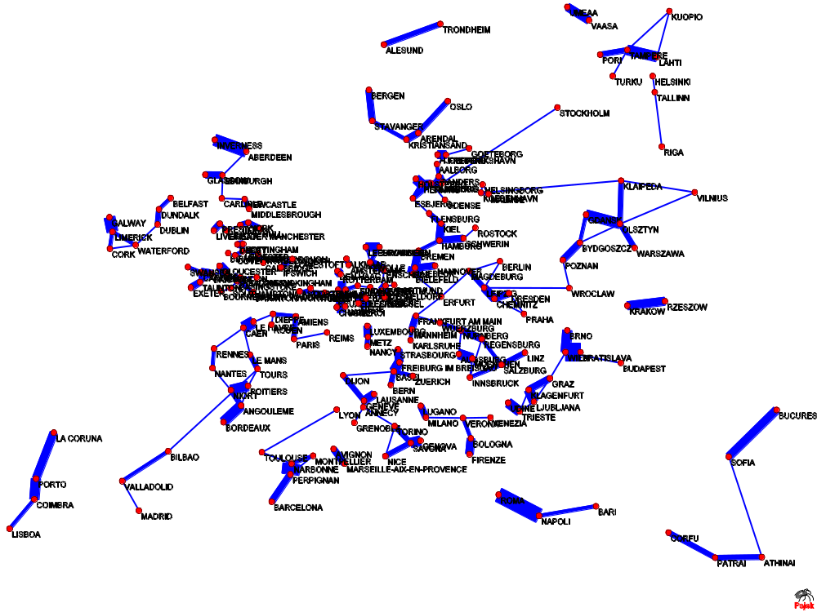
α=7 β=0

Slide 10
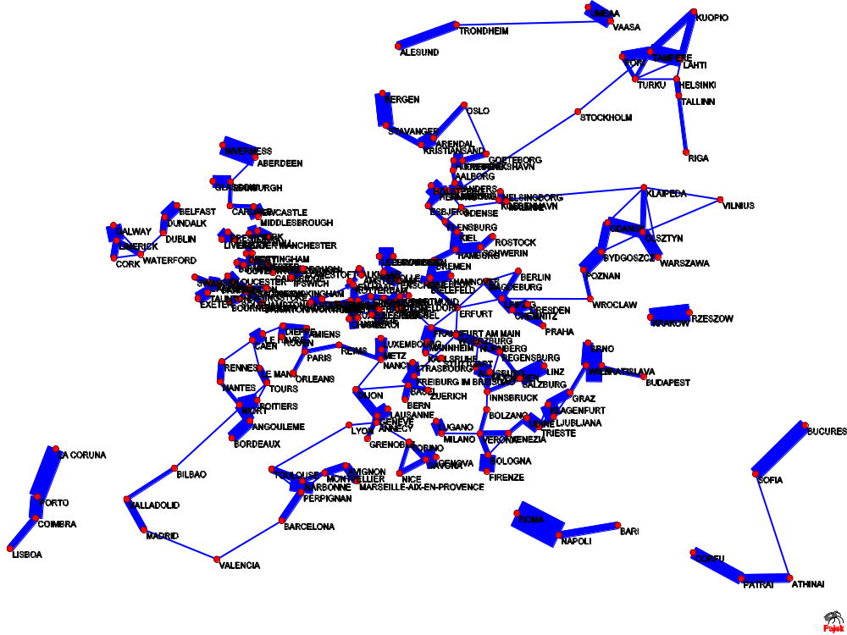
α=7 β=0

Slide 11
Simulation
α=3 β=1

Slide 12
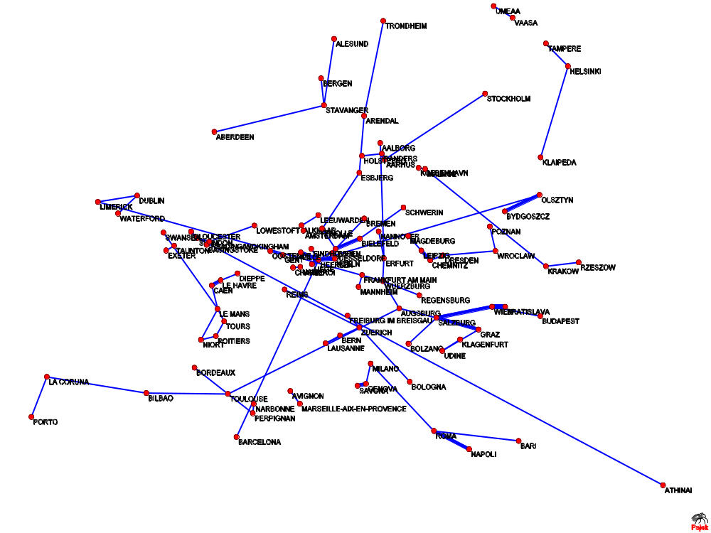
α=3 β=1

Slide 13
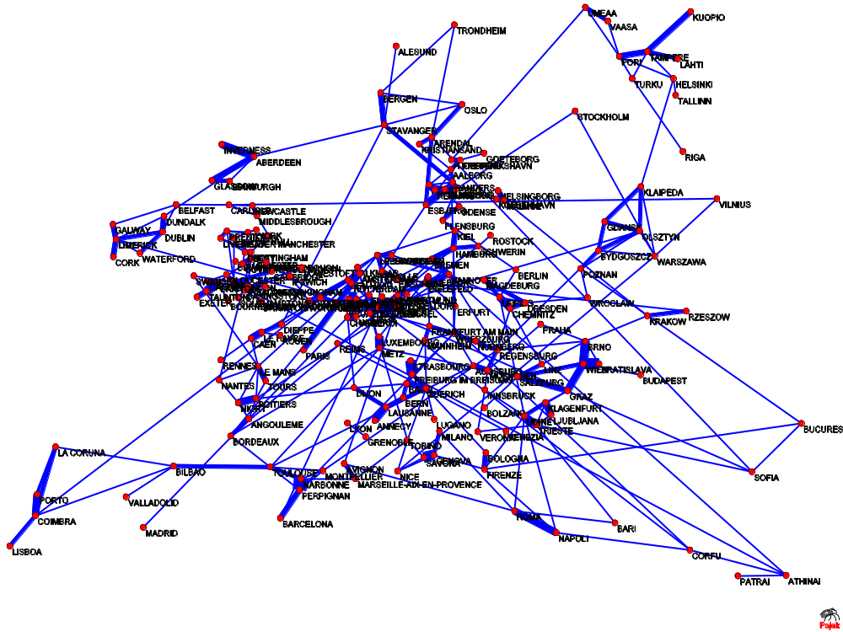
α=3 β=1

Slide 14
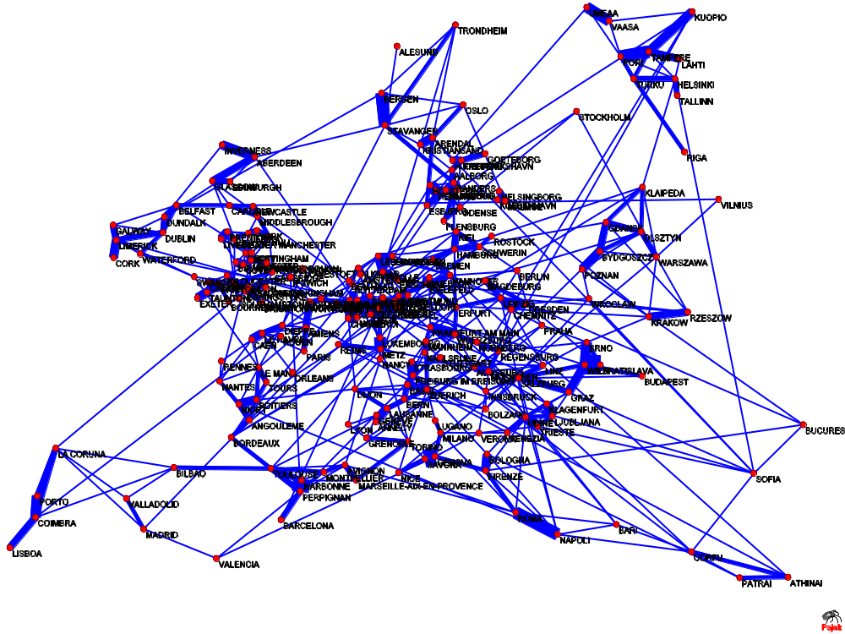
α=3 β=1

Slide 15
Results
We simulated the model for 1300 time steps (that means for a total of 1300 links) for 209 cities entering the network
We compared simulated with real data, for different values of parameters α and β, on the basis of two properties, :
Average path length
Node degree distribution

Slide 16
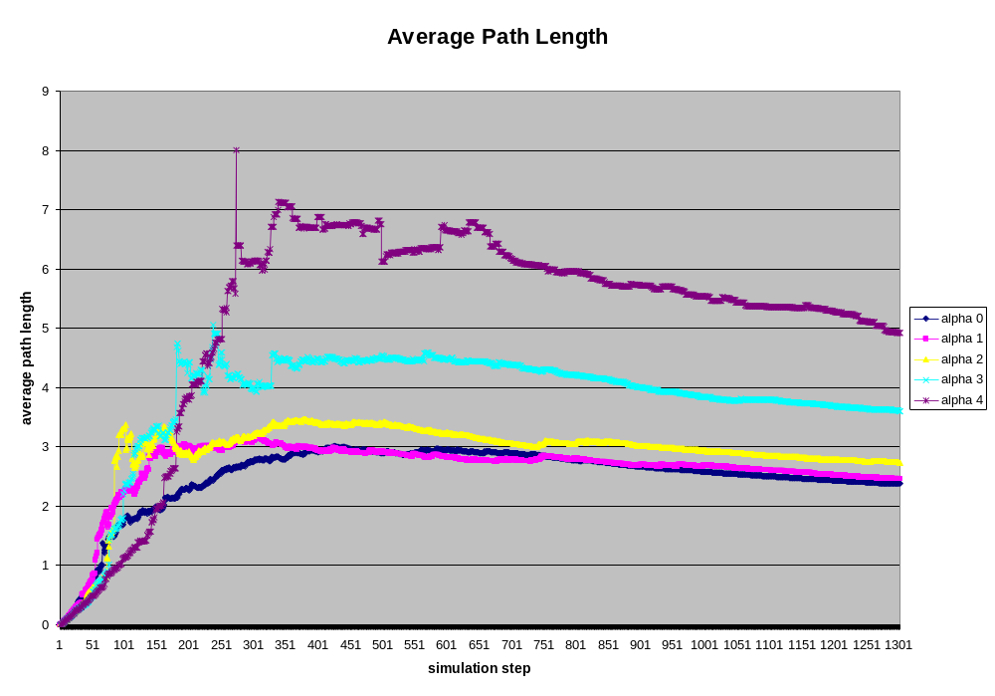
Results on average path length (1300 iterations)

Slide 17
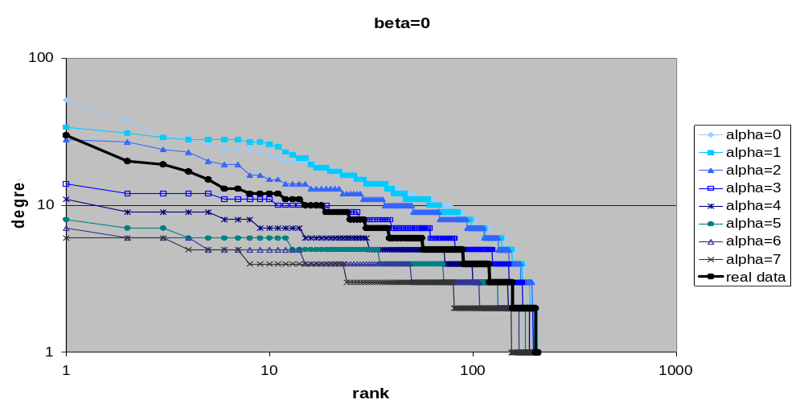
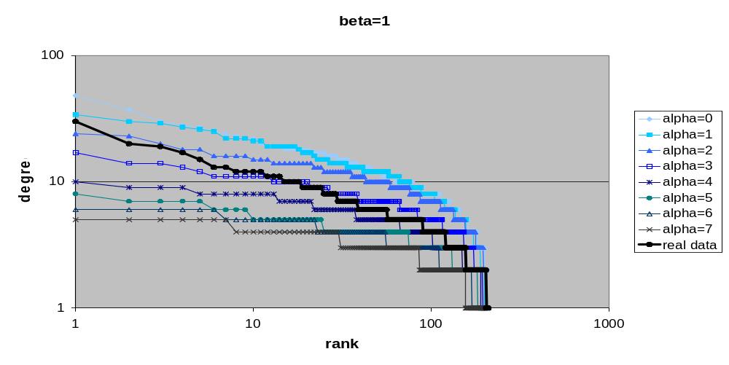
Node degree distribution

Slide 18
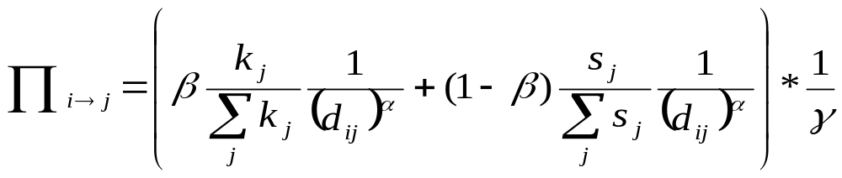
Institutional distance γ
Institutional distance can be easily implemented in the model by assuming that cities within the same country have a higher probability to connect.
Generally for gamma=1 country borders are not important to create a connection while a higher value of γ means that country borders strongly influence the creation connections between two different countries
α ≥ 0, 0 ≤ β ≤ 1, γ ≥ 1

Slide 19
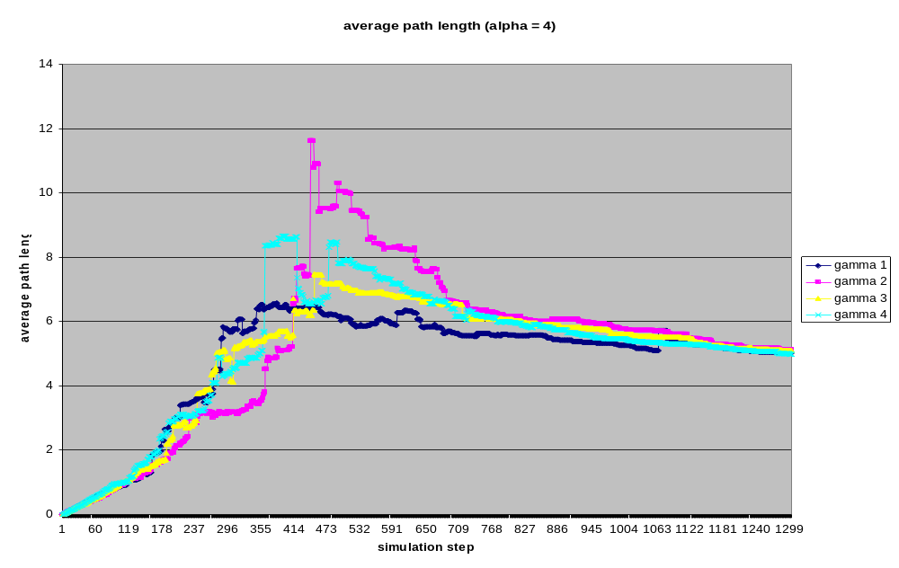
Results on average path length including country barriers and early entrants (London, Paris, Amsterdam, Hamburg)

Slide 20
Simulation
α=4 β=1 γ=4
London - Paris - Amsterdam - Hamburg

Slide 21
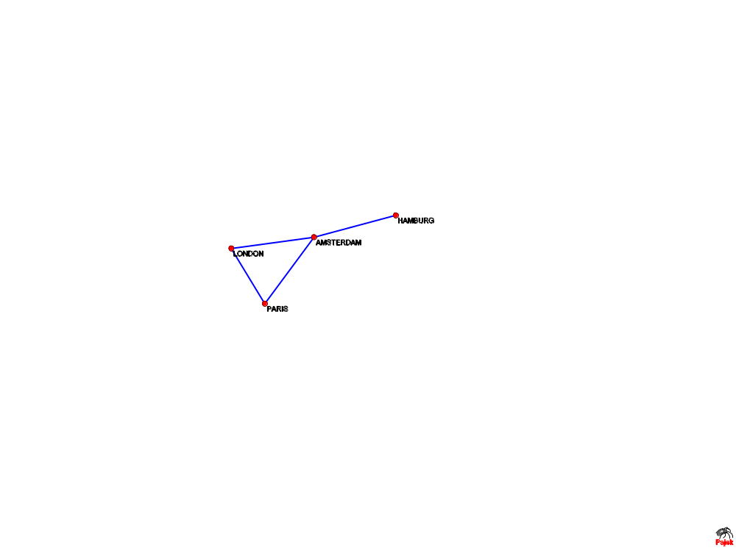

Slide 22
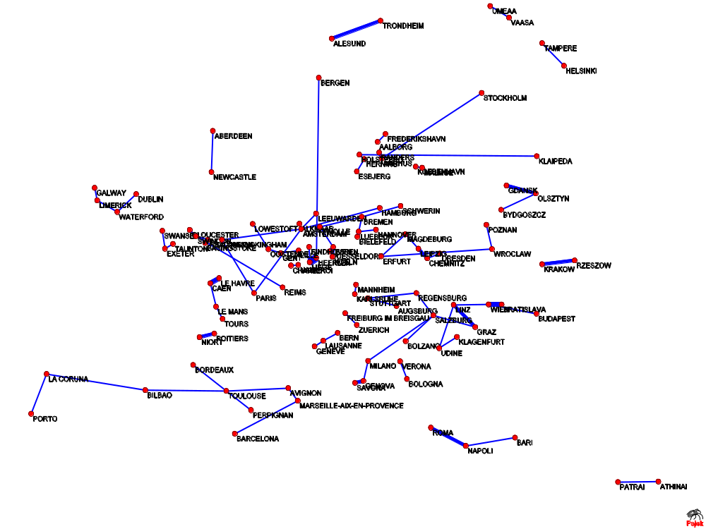

Slide 23
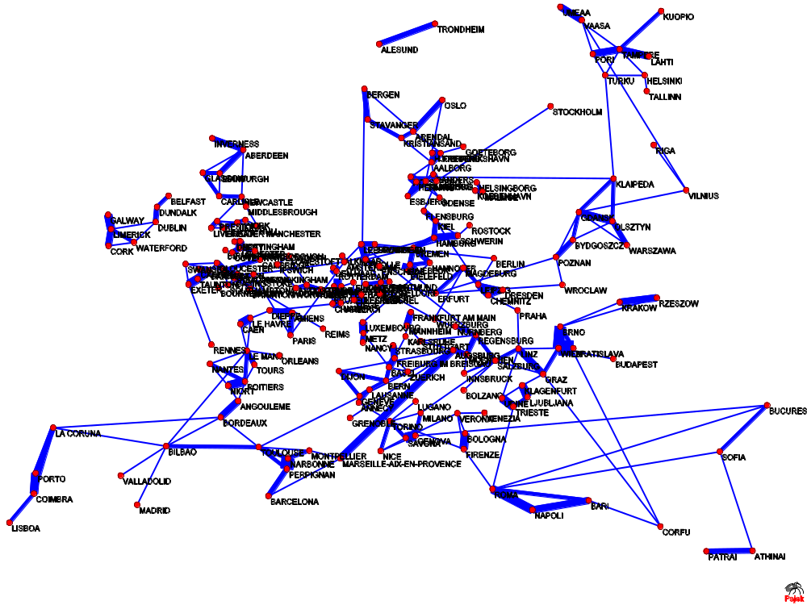

Slide 24
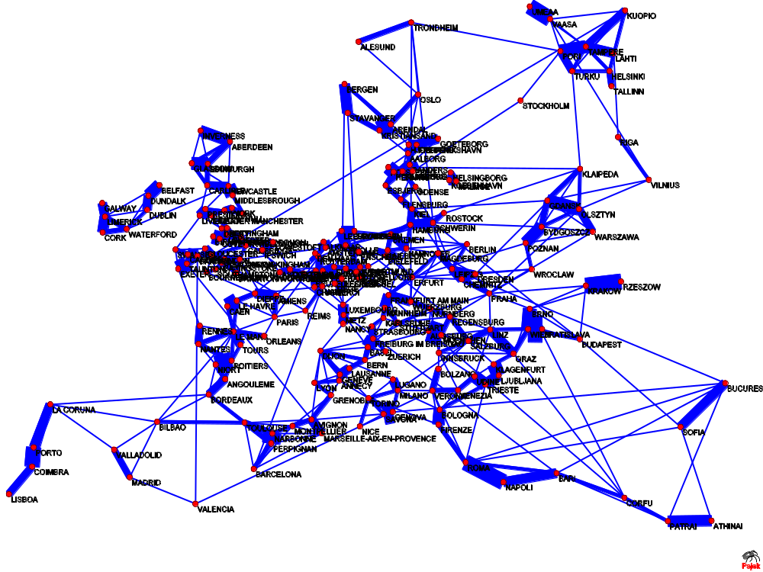

Slide 25
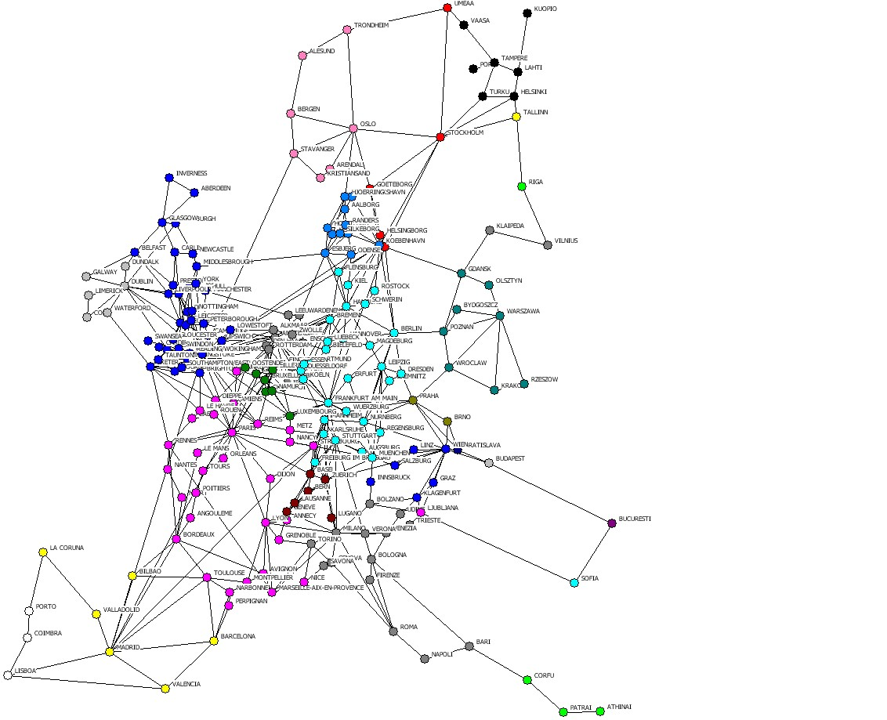
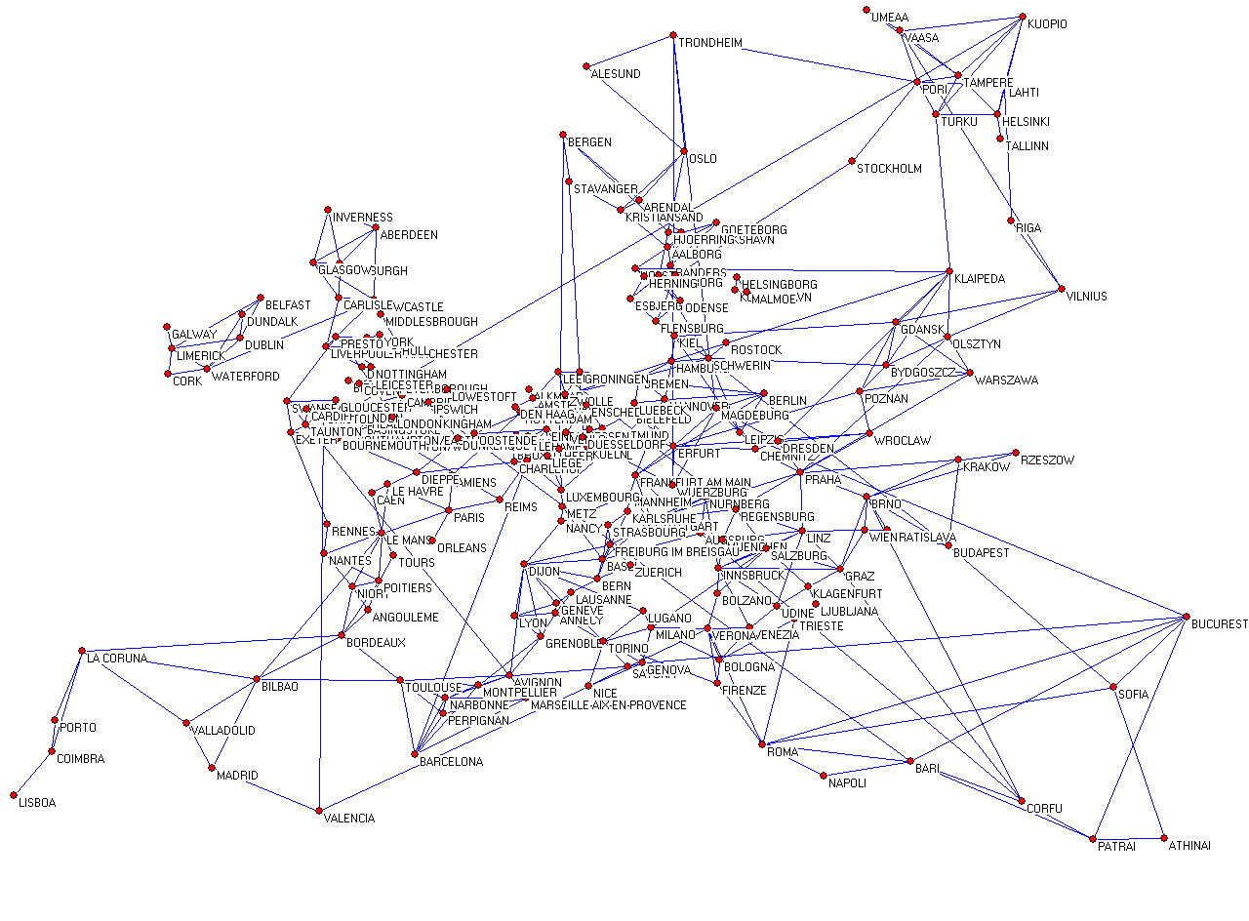
Comparison
real network
simulated network

Slide 26
QAP - correlation
Pearson Correlation: 0.324
P-value: 0.000
Simple Matching: 0.967
P-value: 0.000

Slide 27
Future research
Further examine early entrants
  Academic centers in the 1980s
Validate the model more thoroughly
  Monte Carlo simulations
  Degree distributions
  Weight distributions
  Use U.S. data

Slide 28
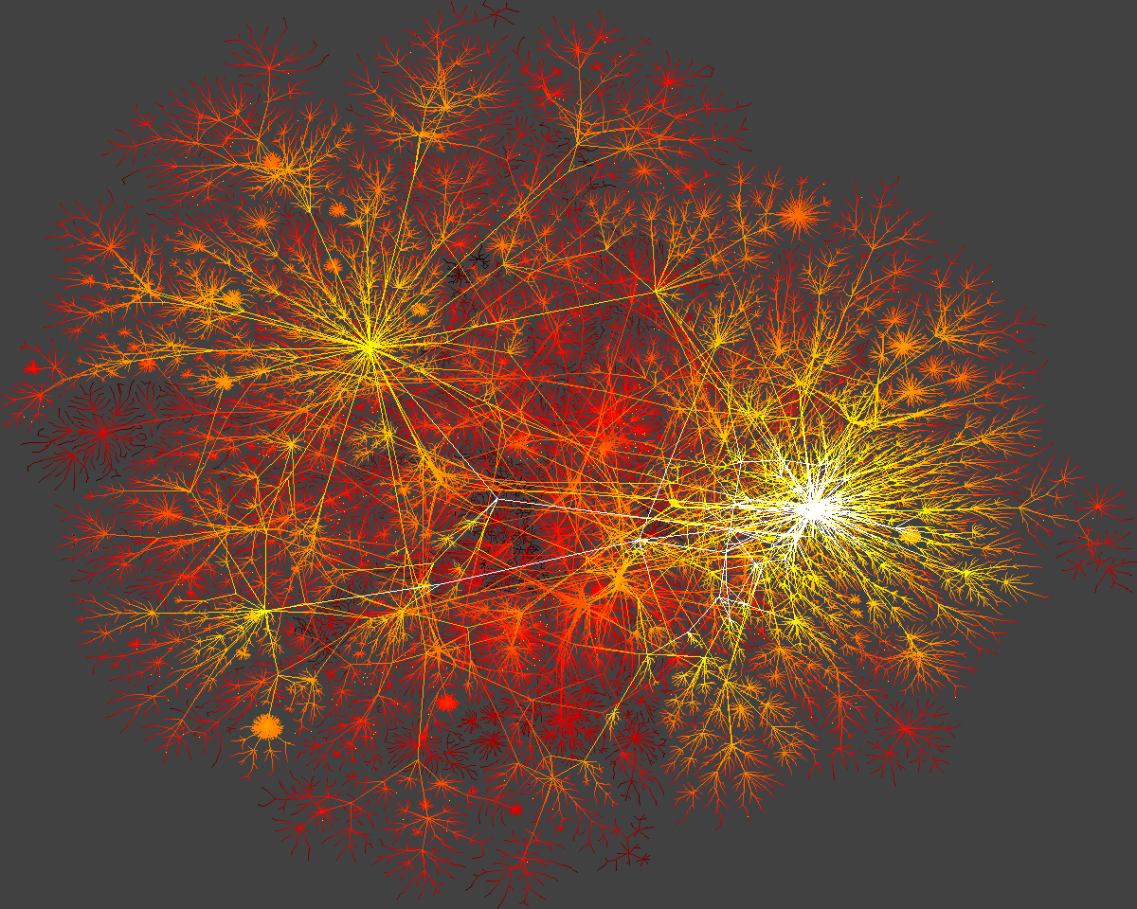
Internet-Map
Thank you

